Slide 1


HIRING PROCESS ANALYTICS
Statistics

Slide 2
Project Overview
In this project, Hiring Process Analytics, we dive into hiring data to uncover insights that can help the company refine its recruitment process. Hiring the right people is crucial, and understanding patterns in gender distribution, salary levels, department representation, and job tiers can make a big difference. As the data analyst on this project, my job is to explore these patterns and provide actionable insights for the hiring team.

Slide 3
Project Objectives
The main goals of this project are to:
Explore Gender Diversity: Understand the balance of male and female hires to see if there’s an opportunity to improve diversity.
Analyze Salary Ranges: Calculate the average salary and break down the salary distribution across different ranges to help gauge competitiveness.
Review Department and Position Levels: Look at the spread of employees across departments and job tiers to identify areas that might need more or fewer resources.
Provide Meaningful Recommendations: Use these insights to help the hiring team make data-driven decisions for a more effective hiring process.

Slide 4
Approach
Data Preparation and Cleaning:
Dealing with Missing Values: Checked the dataset for any gaps or missing information, then either filled in or removed entries as needed to keep the analysis accurate.
Handling Outliers: Spotted any extreme values, especially in salaries, and decided whether to keep, modify, or remove them to prevent skewed results.
Data Analysis and Visualizations:
Gender Distribution: Measured the proportion of male and female hires to get a sense of the company’s gender diversity.
Salary Analysis: Calculated the average salary and set up salary ranges to give a clear picture of salary distribution.
Department and Position Tiers: Created charts to show how employees are spread across different departments and job levels, making it easier to identify areas that may need attention.

Slide 5
Approach
3. Generating Insights: Summed up the key findings and trends from the data, providing recommendations for the hiring team. For instance, this might include advice on improving gender balance, adjusting salary bands, or rebalancing staffing levels in certain departments.
4.Compiling the Report: Put everything together in a report with visualizations, a step-by-step breakdown of the analysis, and clear recommendations. The report will also include a hyperlink to the Excel file so the hiring team can review the detailed data.

Slide 6
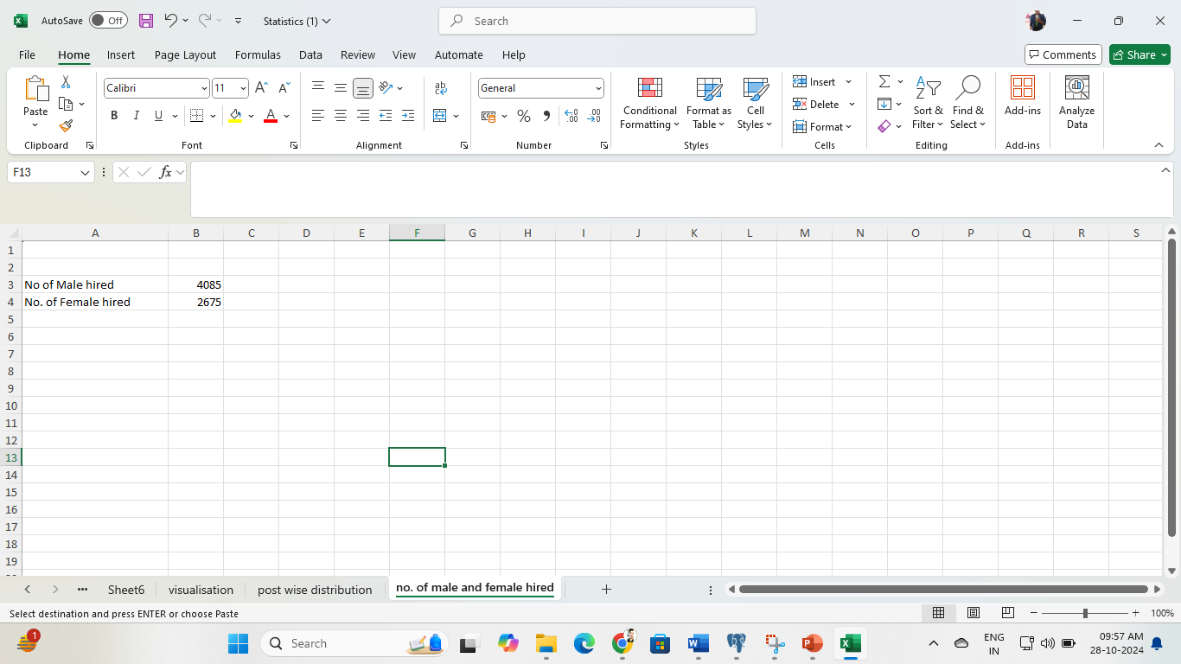
Data Analytics Tasks:
Hiring Analysis: The hiring process involves bringing new individuals into the organization for various roles.
Task: Determine the gender distribution of hires. How many males and females have been hired by the company?
=COUNTIF(Sheet1!D1:D7169,"Male")
=COUNTIF(Sheet1!D2:D7170,"Female")

Slide 7
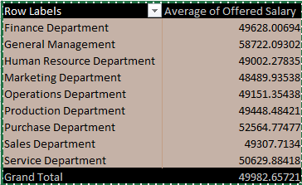
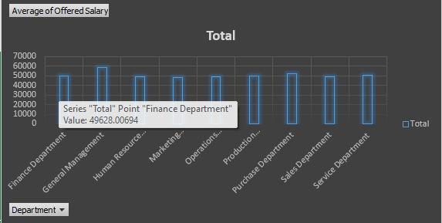

2. Salary Analysis: The average salary is calculated by adding up the salaries of a group of employees and then dividing the total by the number of employees.
Task: What is the average salary offered by this company? Use Excel functions to calculate this.
=SUM(Sheet1!G1:G7169)/COUNT(Sheet1!G1:G7169)

Slide 8
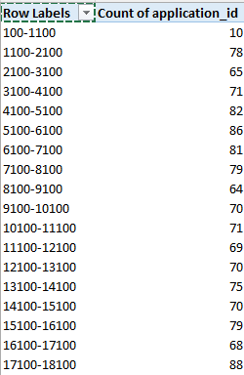
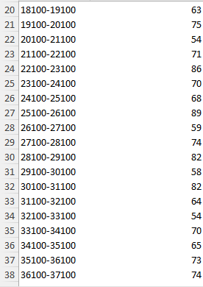
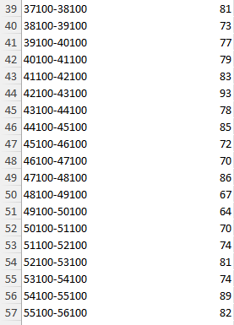
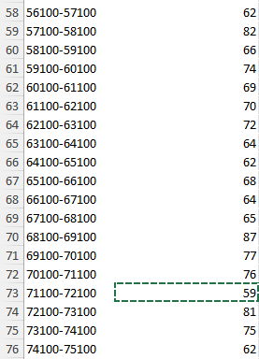
3. Salary Distribution: Class intervals represent ranges of values, in this case, salary ranges. The class interval is the difference between the upper and lower limits of a class.
Task: Create class intervals for the salaries in the company. This will help you understand the salary distribution.

Slide 9
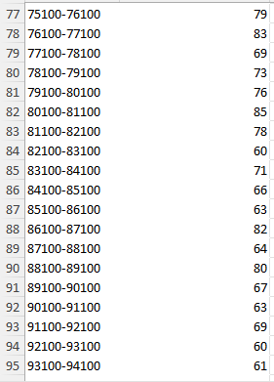
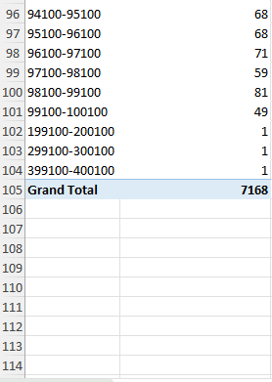

Slide 10
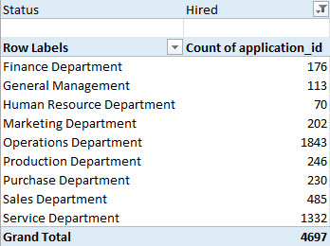
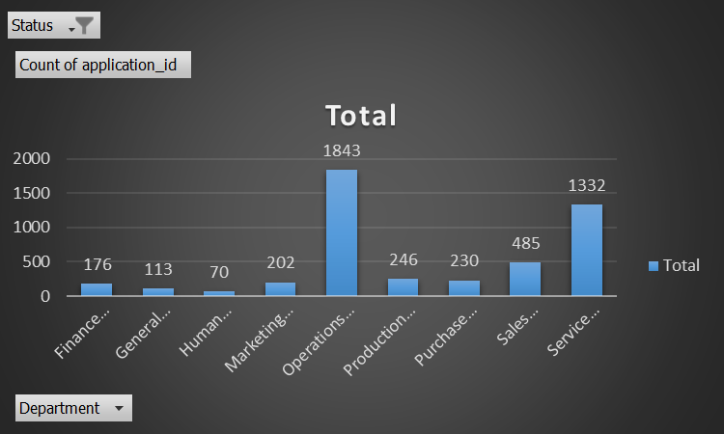
4. Departmental Analysis: Visualizing data through charts and plots is a crucial part of data analysis.
Your Task: Use a pie chart, bar graph, or any other suitable visualization to show the proportion of people working in different departments.

Slide 11
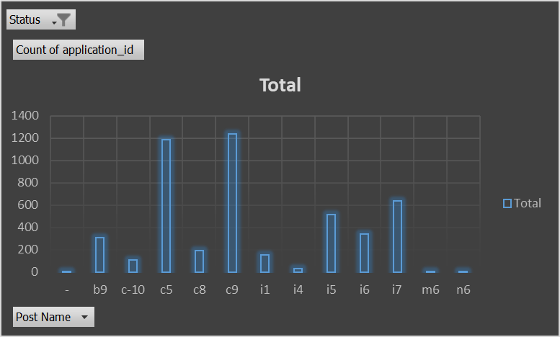
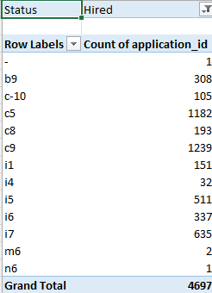
5. Position Tier Analysis: Different positions within a company often have different tiers or levels.
Your Task: Use a chart or graph to represent the different position tiers within the company. This will help you understand the distribution of positions across different tiers.

Slide 12
Result

Slide 13


